Slide 1
AllianceBernstein Capstone Project
2.27 Weekly Update
Hongyu Dai

Slide 2
Previous takeaway
CA Web Scraping
Code need to be improve
Download non-char school & individual data of each char shcool
Potential fields for 5-year time series analysis, which districts are showing the strongest trend
Difficulty: element mapping

Slide 3
Quick Summary
CA Web Scraping
Accomplishment: Scarping code have been completed
nochar & char shool
improve web scraping code
Just need to aggregate them and apply to check if bug (~2h)
TX 5-years trend analysis
Accomplishment: basic code have been completed
Difficulty: Element Mapping -> Solve by pre-processing the datadict data
Still working on: Improve data analysis part

Slide 4
CA Web Scraping
To analyze each report, the reports can be divided into three categories:
On hold: 'Course', 'Profile'
The layout for their report is kind complex
Only 1~2 reports exist within the option and no school type option exists: can be crawled by using the last step of the website. Simplify the process
More number of reports and school type option exists.
Improve the previous code
Add function to download data of individual charter school

Slide 5
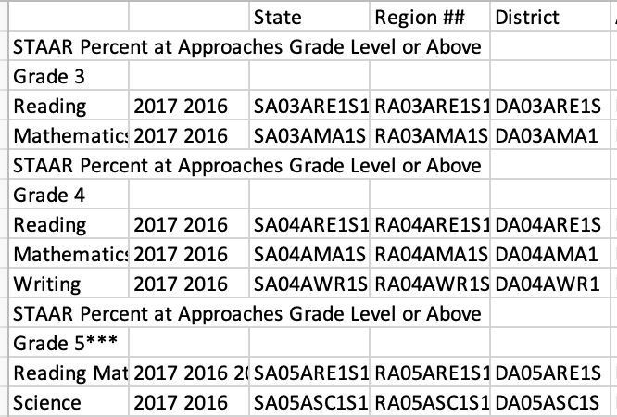
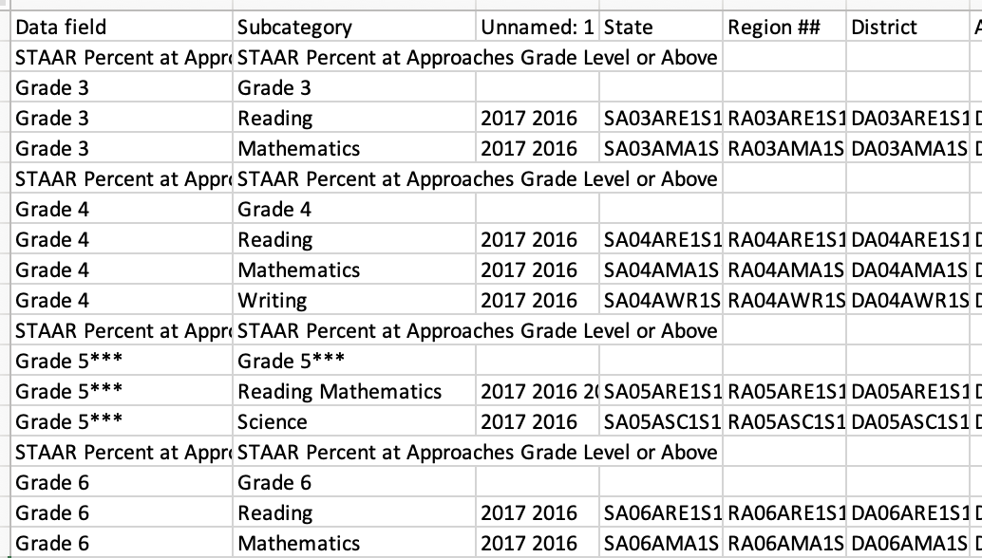
TX 5-years trend analysis
Element Mapping
Try TableQA: work not will in this case
Solve by pre-processing the datadict data: add Data field column, complete Subcategory column
Original Structure After process

Slide 6
Next steps
Aggregate (and improve) CA code
Improve data analysis on TX data
To be discuss on meeting

